Slide 1
Computed tomographic analysis of NTM lung disease reveals a surprising finding…but not for TB clinicians of years past Edward Bosko, Jiwon Lyu, Valerie A. Hale, Kum Ju Chae, Nathaniel M. Ivanick, Jared J. Eddy, David E. Griffith, Matthew J. Strand, Edward D. Chan Colorado School of Public Health, University of Colorado Anschutz Medical Campus, Aurora, Colorado; Soon Chun Hyang University Cheonan Hospital, Seoul, Korea National Jewish Health, Denver, Colorado; Rocky Mountain Regional Veterans Affairs Medical Center, Aurora, Colorado; State University of New York Jacobs School of Medicine and Biomedical Sciences, Buffalo, NY; Jeonbuk National University Hospital, Seoul, South Korea
ChanE@NJHealth.org
Edward.Chan@va.gov
Research in Progress
October 17, 2025
Notes:
CAT scan or CT scan is a common medical test

Slide 2
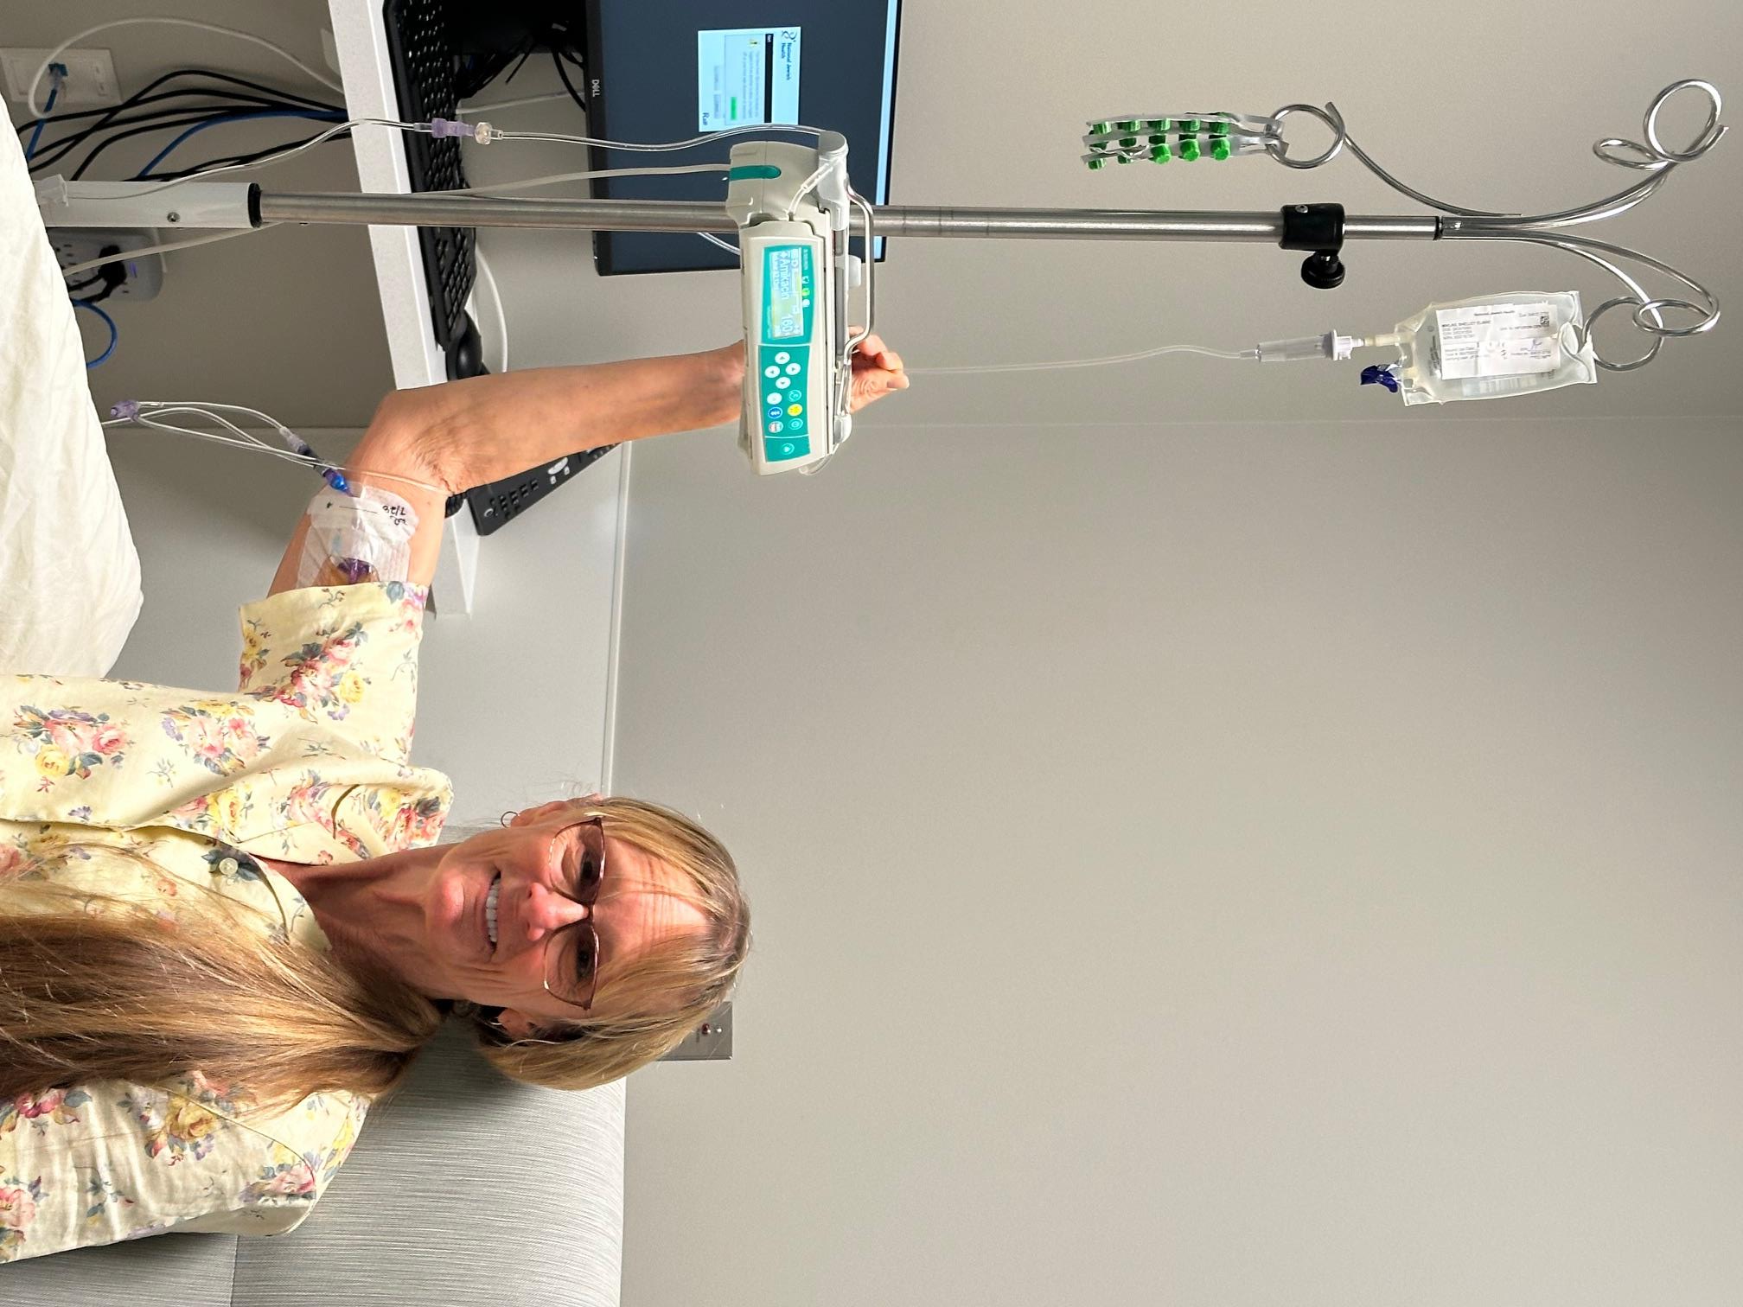
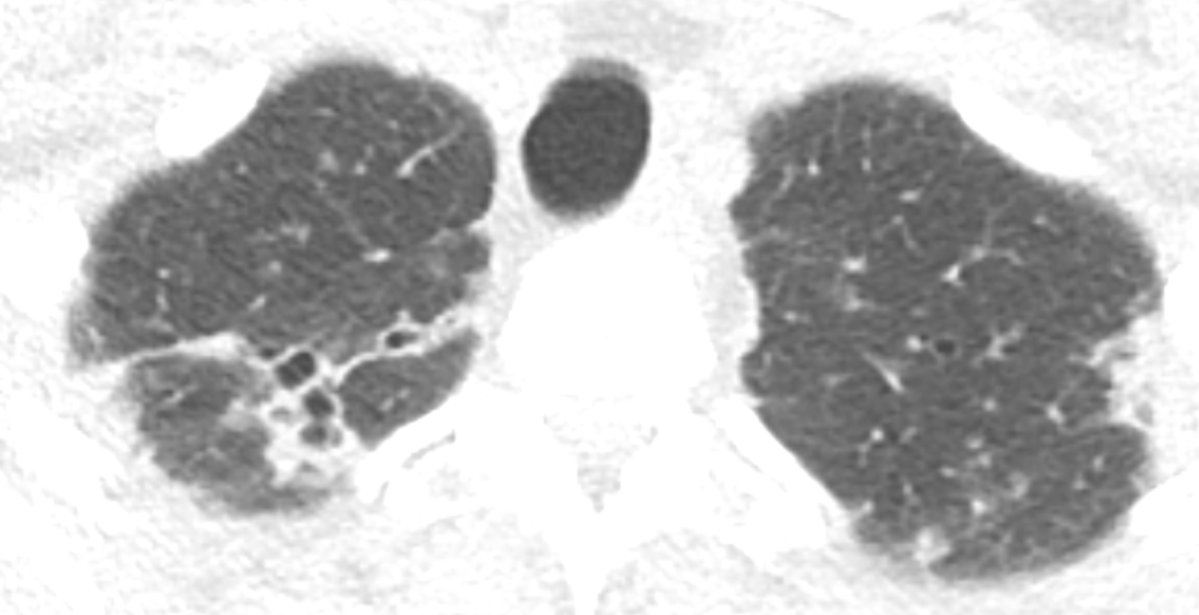
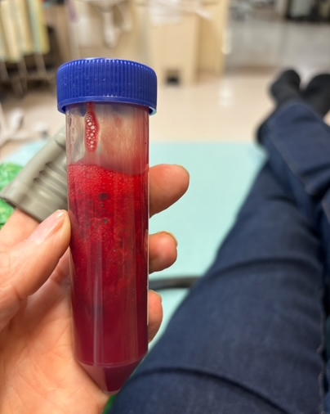
68-year-old woman with Mycobacterium abscessus lung disease.
Is the administration of the IV antibiotics optimal in this picture?
NJH Infusion Clinic
Although her BXSIS is relatively mild, she has recurrent severe hemoptsis.
I’d say no!
She is on 4 antibiotics that include IV imipenem and amikacin.
Permission obtained from patient & husband

Slide 3
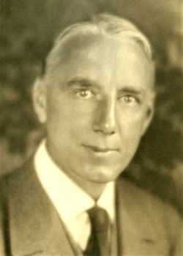
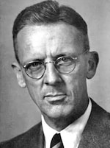

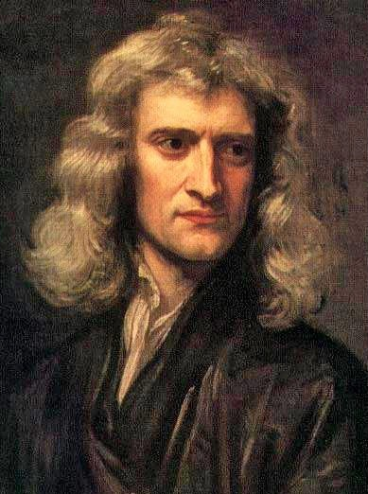
People who would support my answer
Gerald Bertram Webb, MD
(1871-1949)
TB clinician & researcher
Webb-Waring Lung Institute
William Dock, MD
(1898-1990)
cardiologist
John F. Murray, MD
(1927-2020)
Pulmonologist
Isaac Newton
(1643-1727)

Slide 4
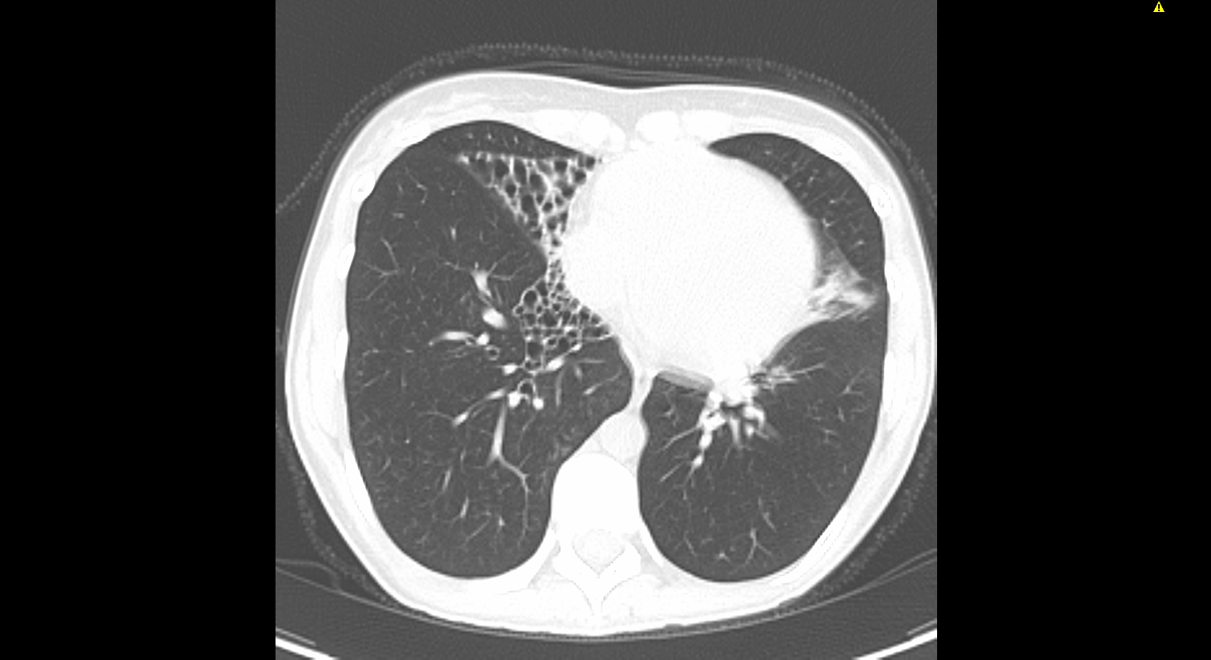
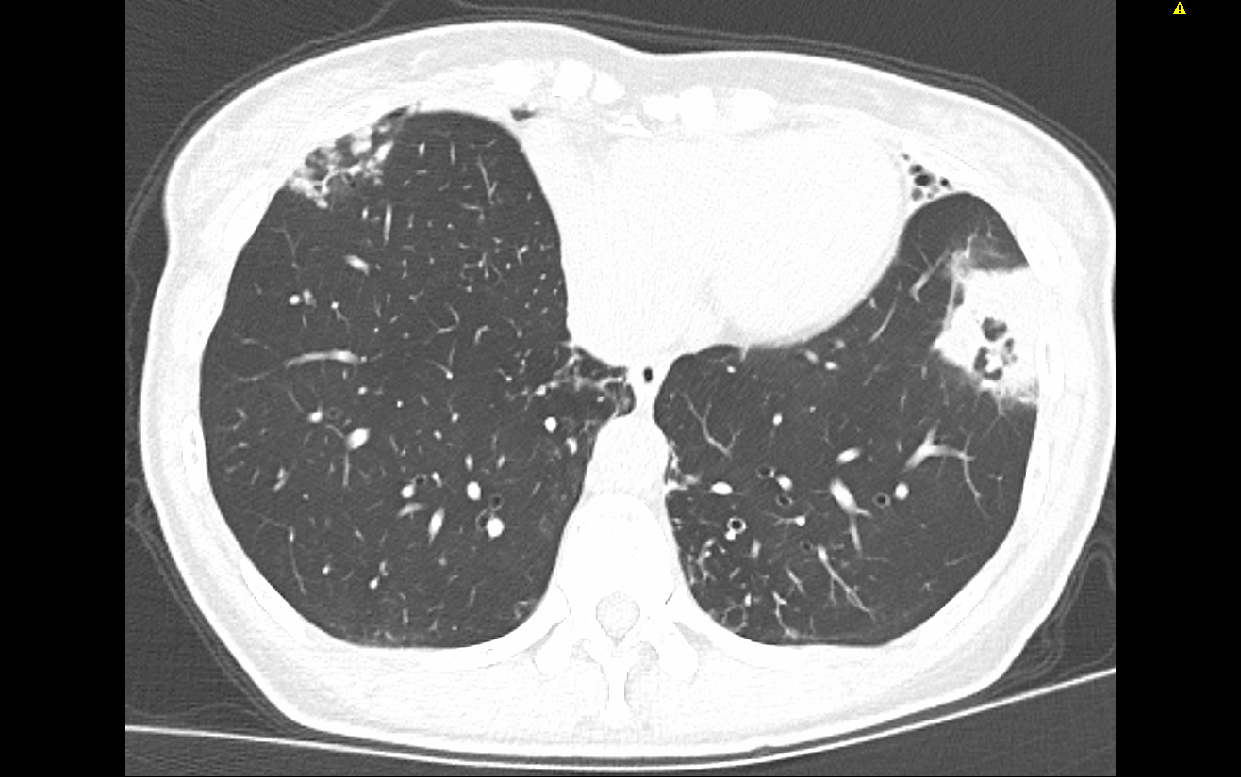
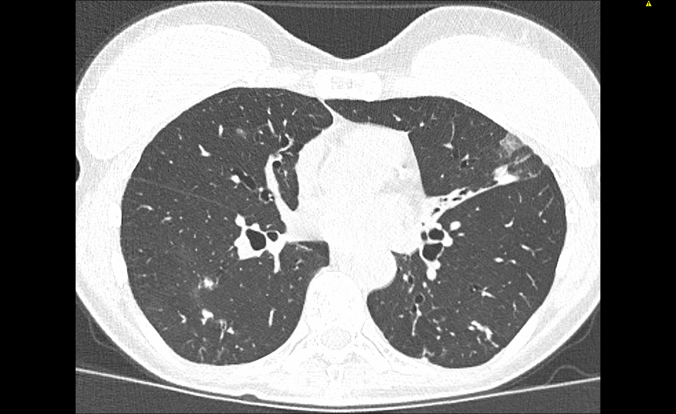
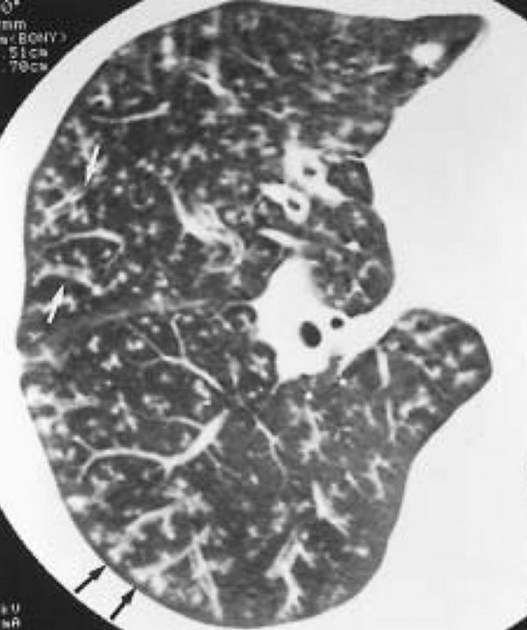
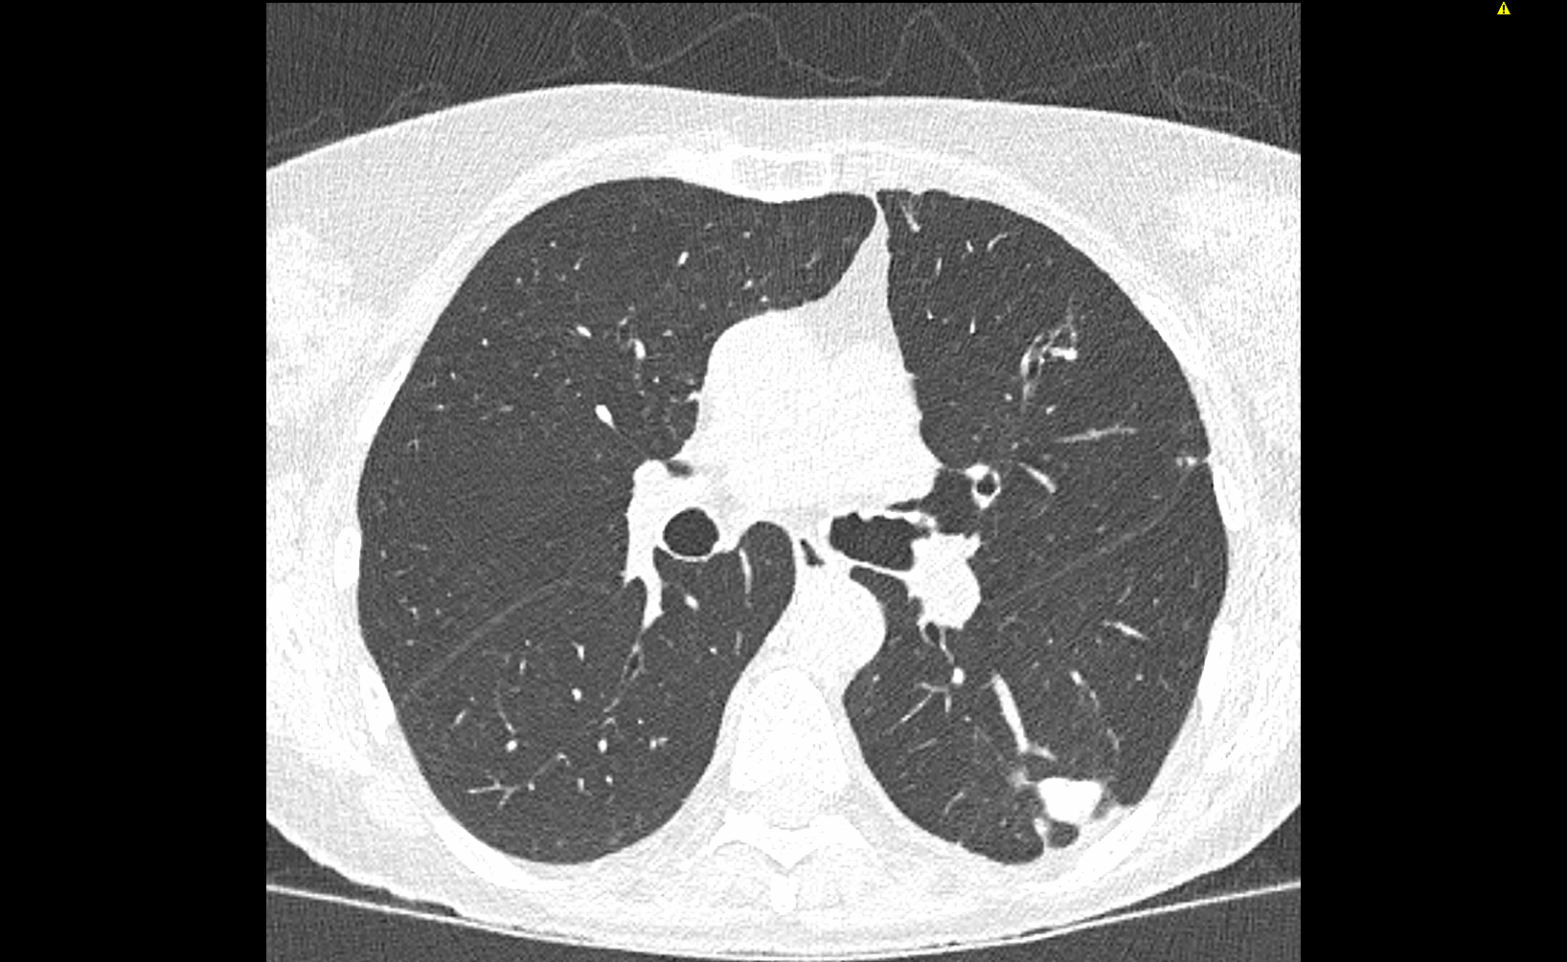
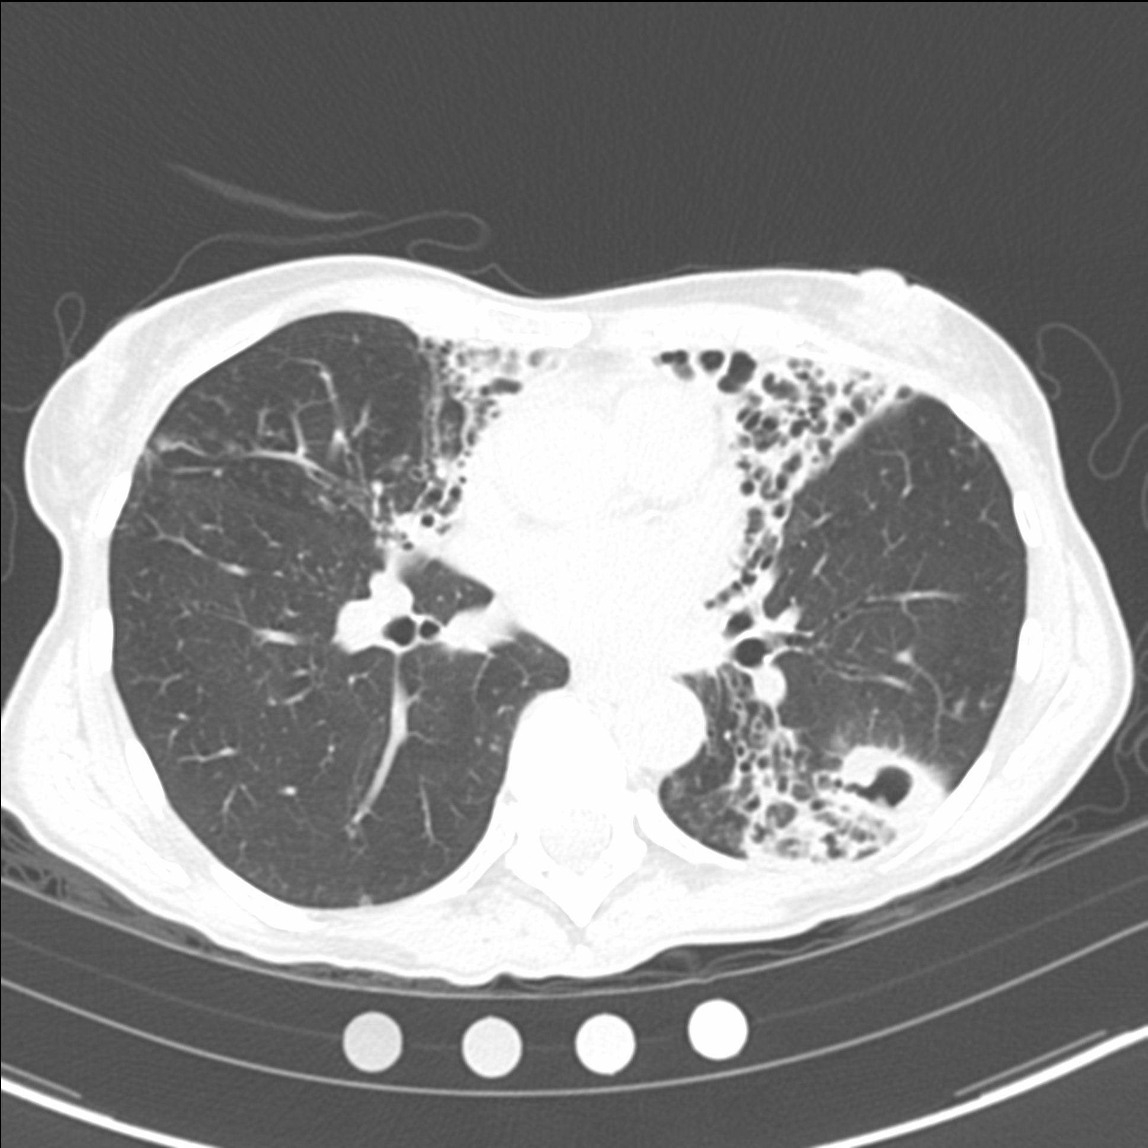
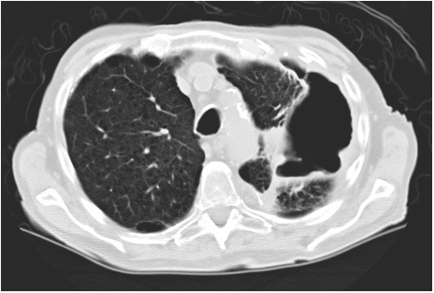
CT features of NTM lung disease analyzed
Tree-in-bud opacities
Atelectasis
Bronchiectasis
Consolidation
GGO
Large nodules (≥ 1 cm)
Cavitation of nodules
Fibrocavitary disease
Notes:
CT features of NTM-LD include….these 5 features lend themselves to be semi-quantified with ordinal analysis. We also analyzed for large nodules and cavities.

Slide 5
Question
What is the frequency of each CT feature in each of the lung lobes in NTM lung disease?
LUS
RUL
RML
Lingu
RLL
LLL
Notes:
So we were curious to find out…

Slide 6
METHOD of CT scoring
Chest CTs of 166 NTM-LD patients were classified into four CT phenotypes: (i) nodular-bronchiectasis (NB), (ii) NB with cavitation (NBc), (iii) fibrocavitary disease, or (iv) unclassifiable.
NB
NBc
Fibrocavitary disease
Chest CTs were analyzed by a chest radiologist and a pulmonologist in each of the (six) lobes.
Five ordinal CT features (atelectasis, bronchiectasis, consolidation, GGO, & tree-in-bud opacities) were scored for each lobe: Grade 0 (none), Grade 1 (<25% of the lobe involved), Grade 2 (25-50%), and Grade 3 (>50%).
Two binary CT features (large nodules and cavities) were scored as presence and absence.

Slide 7
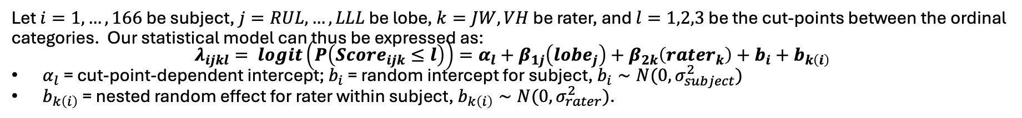
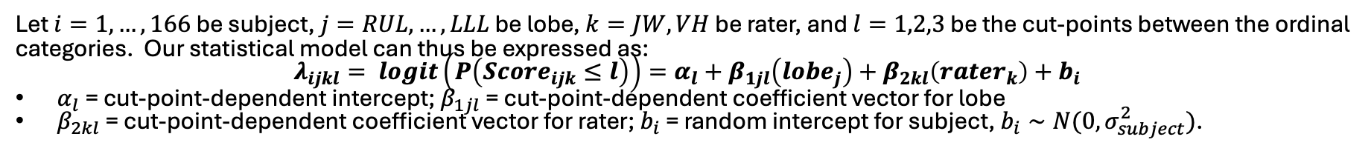
METHODS (statistical analyses) Matt Strand, PhD (biostatistician), Edward Bosko, MS biostatistics candidate
Both ordinal and binary features were modeled using ordinal and binary logistic regression.
Lobes were compared using t-tests derived from these models.
Separate models were fitted for each CT feature.
Modeling Approach 1 – (Binary) Logistic Regression (Full)
Let $i=1, …, 166$ be subject, $j=RUL, …, LLL$ be lobe, and $k=JW, VH$ be rater. Our statistical model can thus be expressed as: $λ_{ijk}= logit\left(P\left(Score_{ijk}=1\right)\right)=β_{0}+β_{1j}\left(lobe_{j}\right)+β_{2k}\left(rater_{k}\right)+b_{i}+b_{k\left(i\right)}$
$b_{i}$ = random intercept for subject, $b_{i}∼N\left(0,σ_{subject}^{2}\right); b_{k\left(i\right)}$ = nested random effect for rater within subject, $b_{k\left(i\right)}∼N(0,σ_{rater}^{2})$
Modeling Approach 3 – Proportional Odds Ordinal Logistic Regression (Full)
Let $i=1, …, 166$ be subject, $j=RUL, …, LLL$ be lobe, $k=JW, VH$ be rater, and $l=1,2,3$ be the cut-points between the ordinal categories. Our statistical model can thus be expressed as:
$$λ_{ijkl}= logit\left(P\left(Score_{ijk}≤l\right)\right)=α_{l}+β_{1j}\left(lobe_{j}\right)+β_{2k}\left(rater_{k}\right)+b_{i}+b_{k\left(i\right)}$$
$α_{l}$ = cut-point-dependent intercept; $b_{i}$ = random intercept for subject, $b_{i}∼N(0,σ_{subject}^{2})$
$b_{k\left(i\right)}$ = nested random effect for rater within subject, $b_{k\left(i\right)}∼N(0,σ_{rater}^{2})$.
Modeling Approach 5 – Non-Proportional Odds Ordinal Logistic Regression
Let $i=1, …, 166$ be subject, $j=RUL, …, LLL$ be lobe, $k=JW, VH$ be rater, and $l=1,2,3$ be the cut-points between the ordinal categories. Our statistical model can thus be expressed as:
$$λ_{ijkl}= logit\left(P\left(Score_{ijk}≤l\right)\right)=α_{l}+β_{1jl}\left(lobe_{j}\right)+β_{2kl}\left(rater_{k}\right)+b_{i}$$
$α_{l}$ = cut-point-dependent intercept; $β_{1jl}$ = cut-point-dependent coefficient vector for lobe
$β_{2kl}$ = cut-point-dependent coefficient vector for rater; $b_{i}$ = random intercept for subject, $b_{i}∼N(0,σ_{subject}^{2})$.

Slide 8
RESULTS
Patient characteristics
 | NB (n=108) | NBc (n=36) | Fibrocavitary (n=13) | Unclassified (n=9) | p-value
Age (mean yrs ± SD) | 66.8 ± 10.0 | 65.6 ± 7.2 | 67.5 ± 7.3 | 58.4 ± 14.7 | 0.088
Female sex [n (%)] | 99 (91.7%) | 34 (94.4%) | 11 (84.6%) | 8 (88.9%) | 0.733
NB
NBc
Fibrocavitary disease

Slide 9
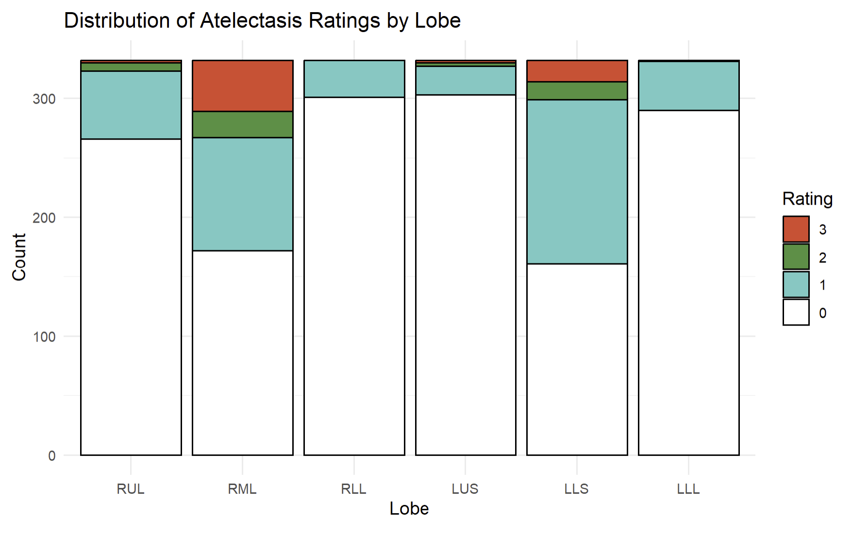
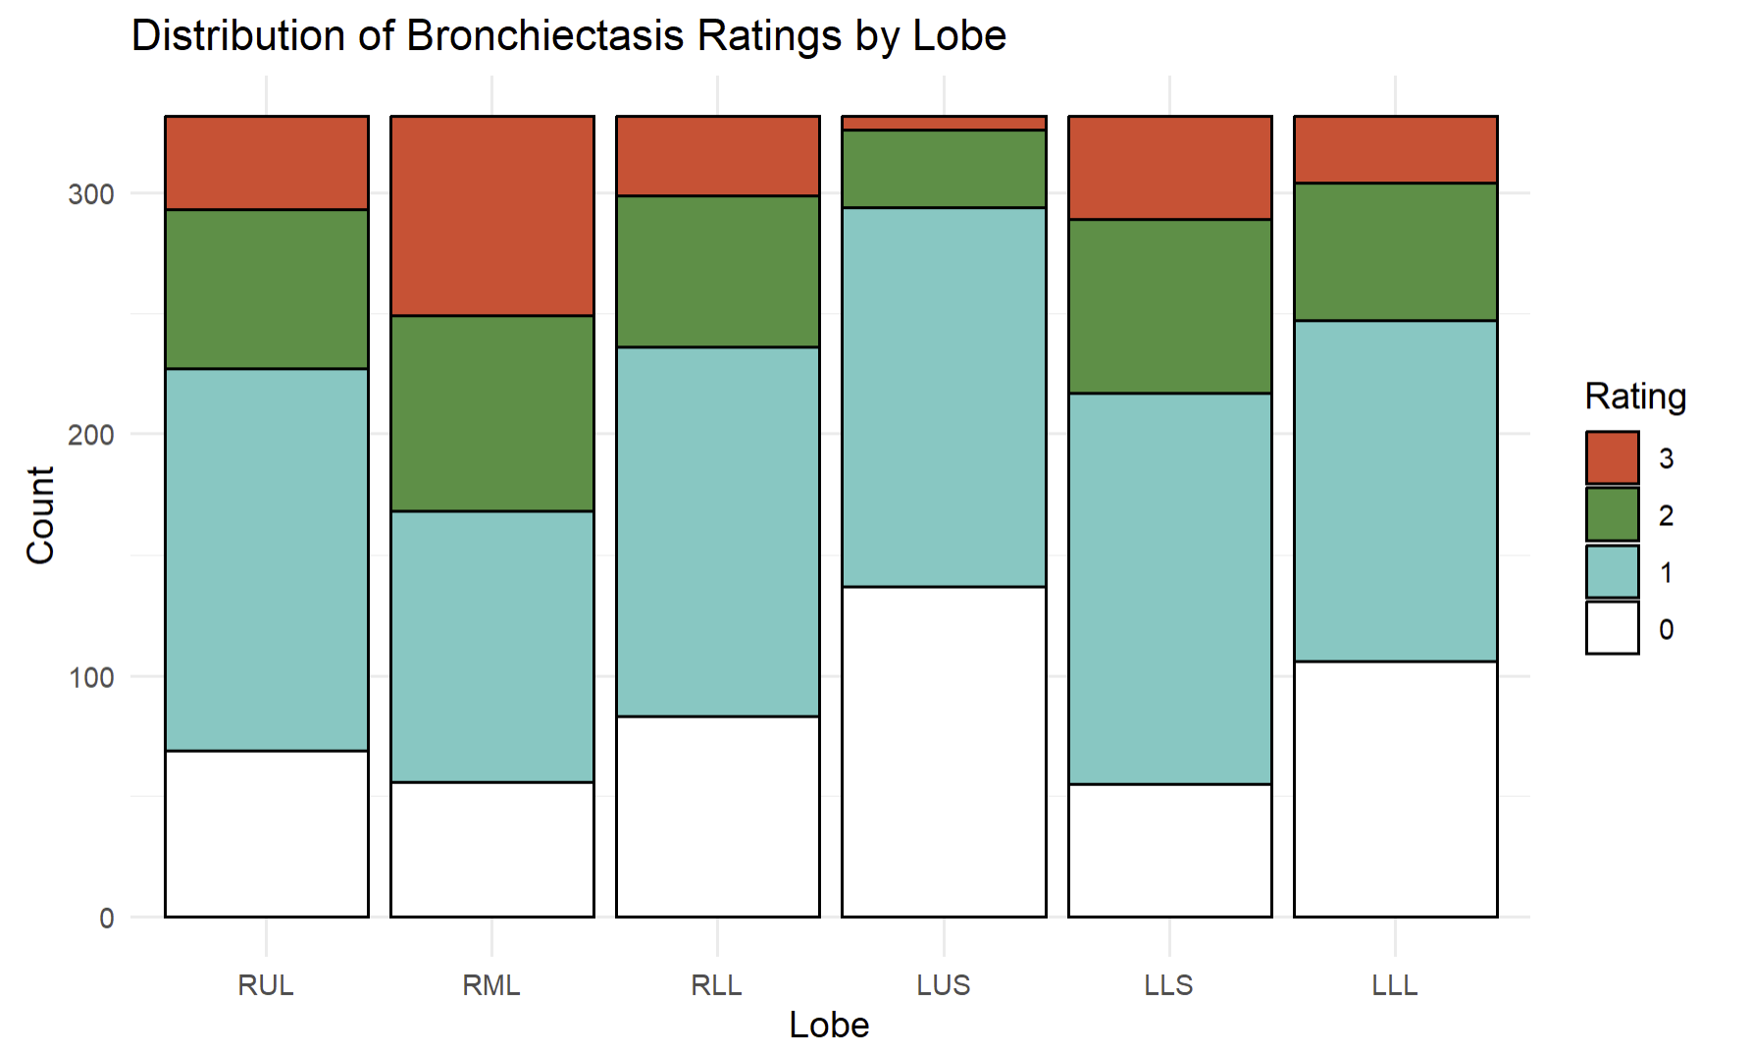

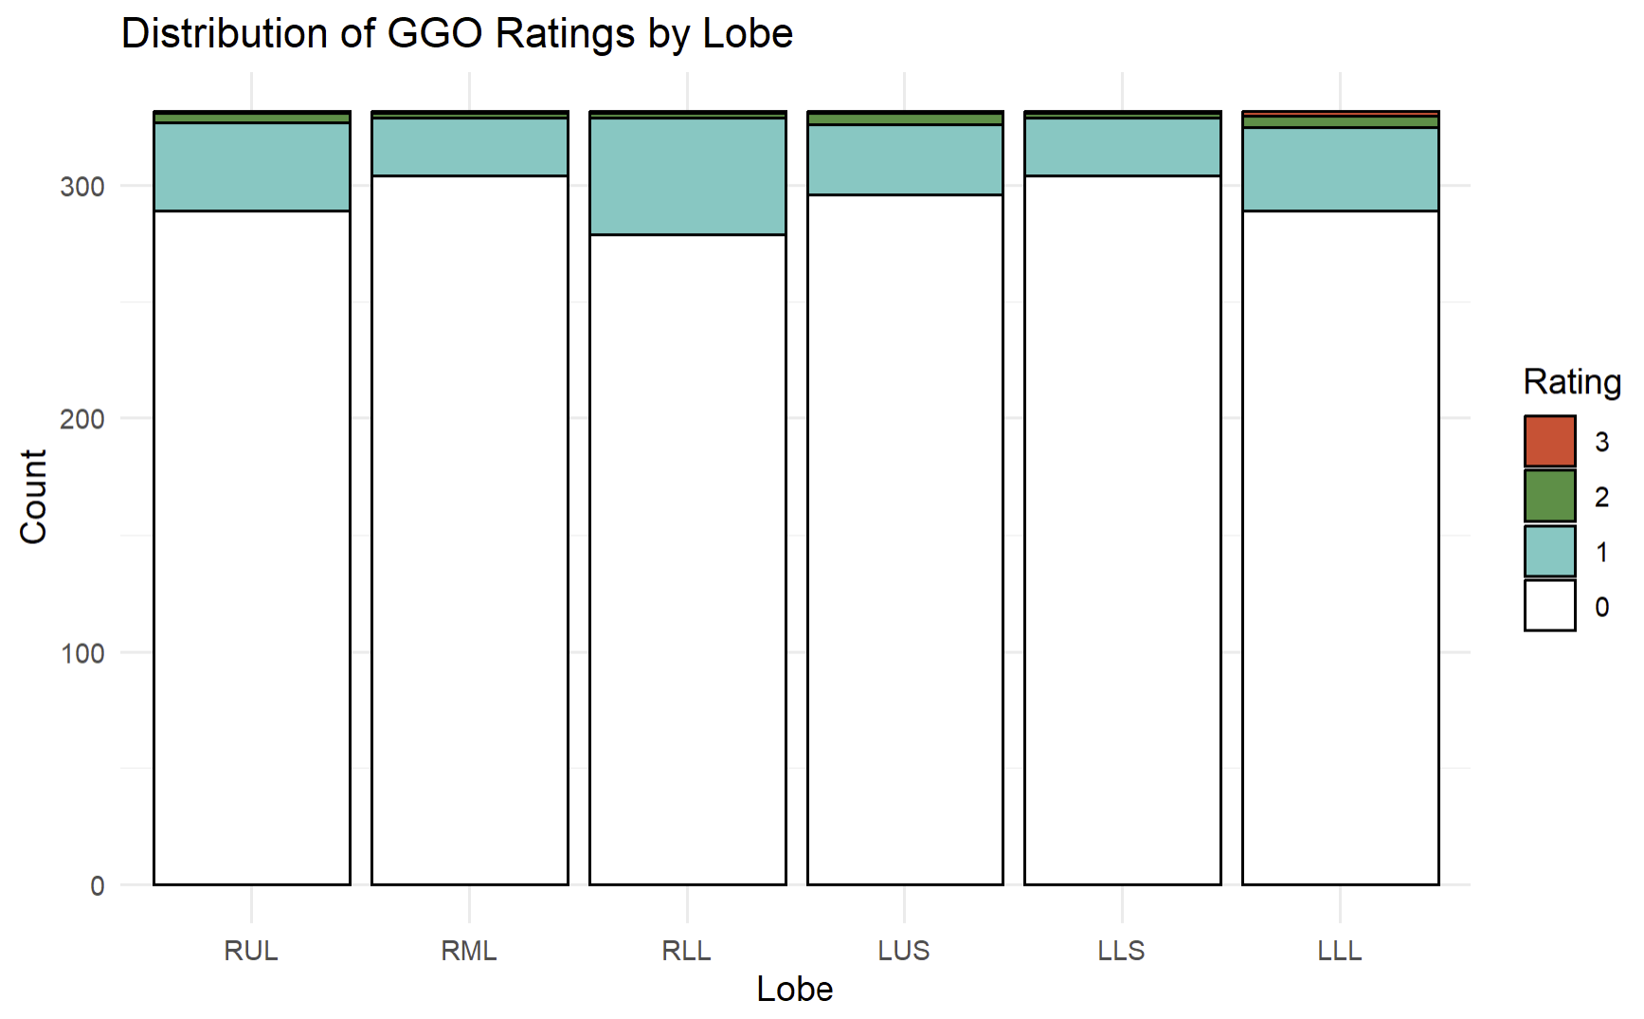
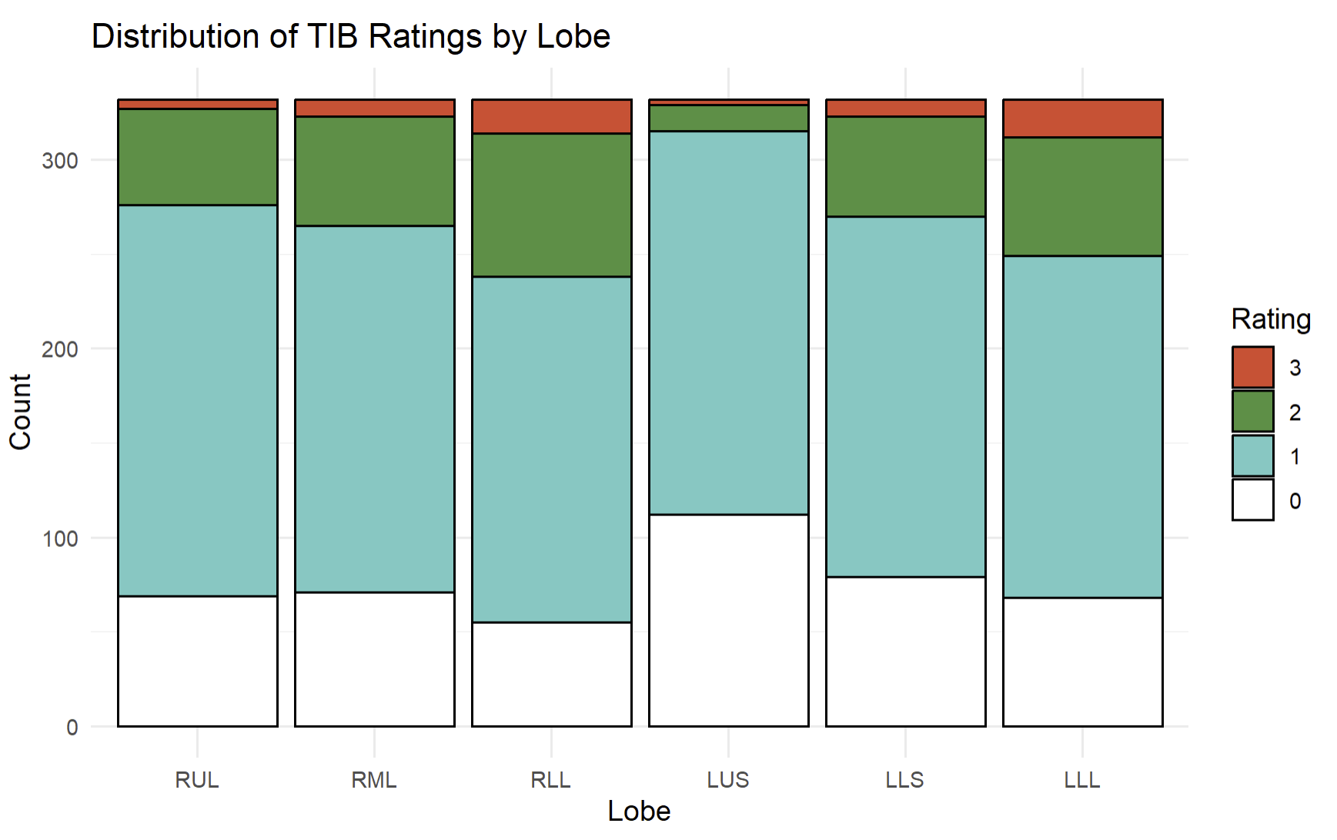
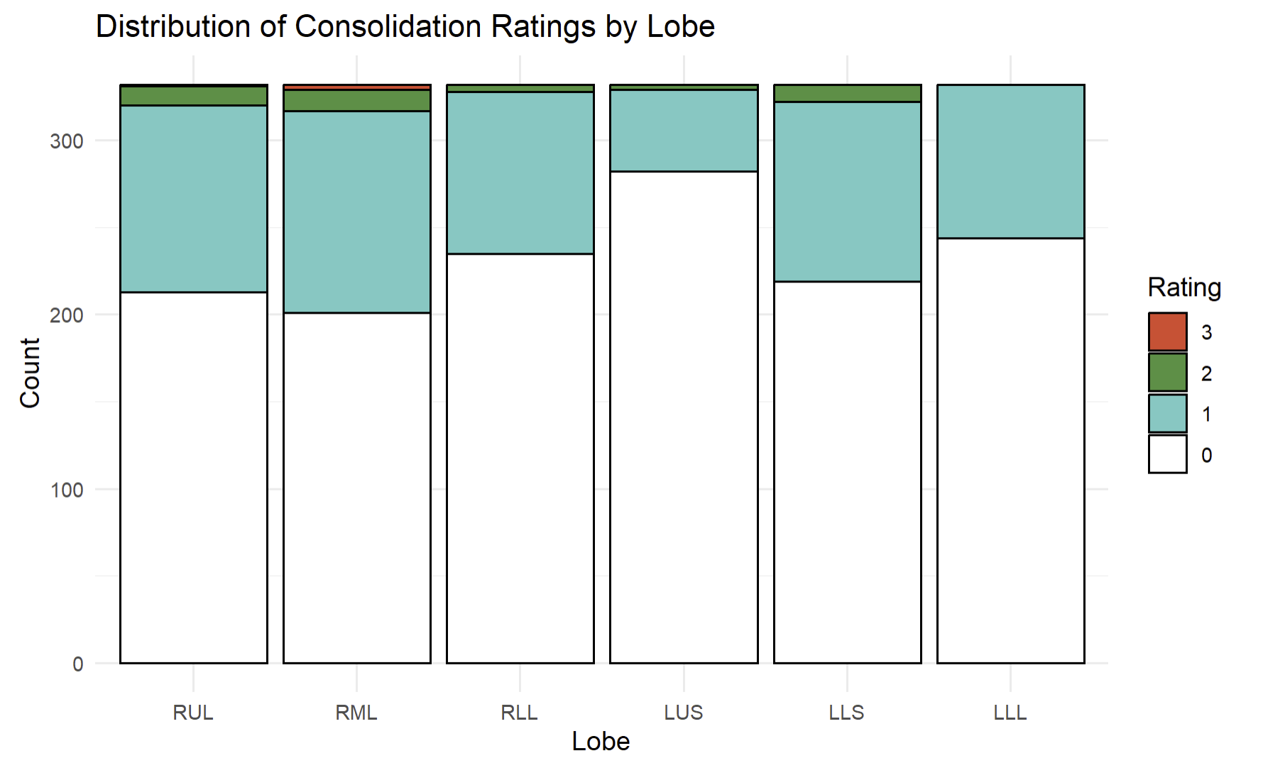
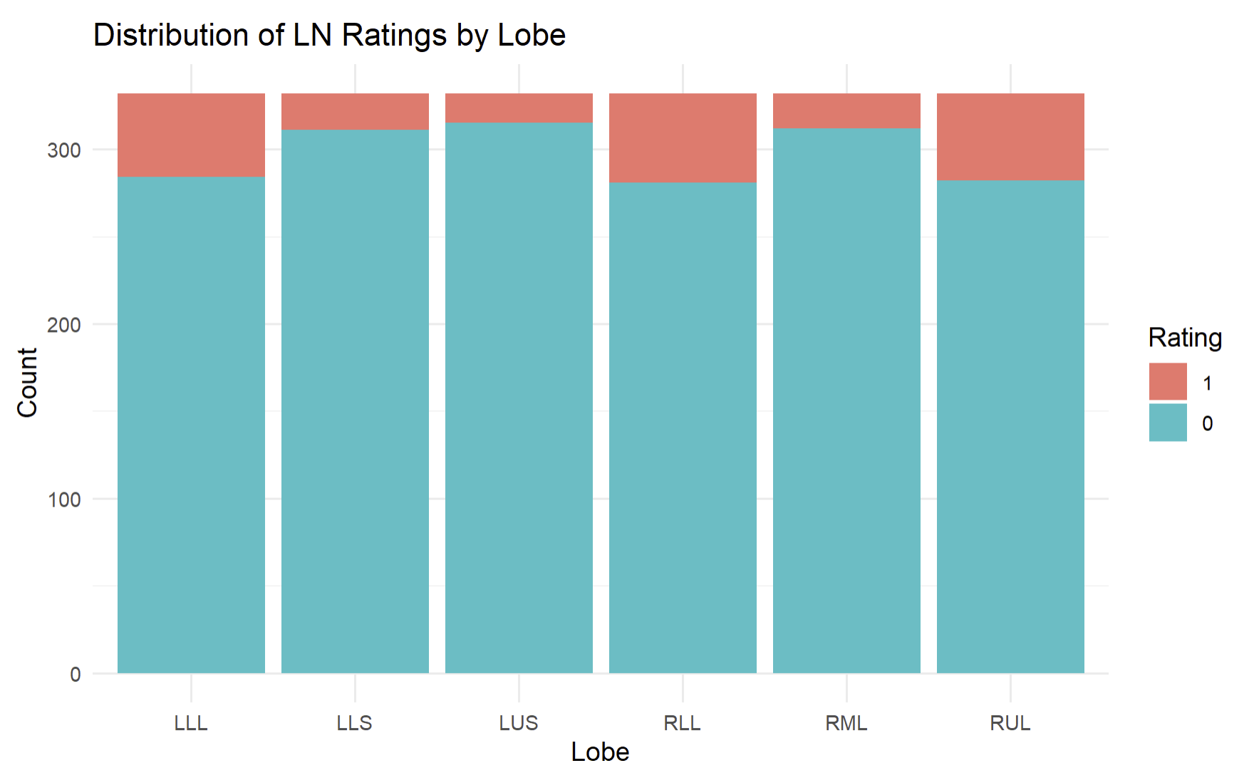
The lobes most commonly affected are also most severely affected
Atelectasis: Lingu, RML, RUL > others (OR 1.71-20.45)
GGO: RLL, LLL, RUL > others (OR 2.04-3.14)
Counts
RUL
RML
RLL
LUS
Ling
LLL
Counts
RUL
RML
RLL
LUS
Ling
LLL
Grade
300
300
3
200
2
200
100
1
100
0
Bronchiectasis: RML, Lingu > others (OR 1.76-22.58)
TIB: RLL, LLL > others (OR 1.60-6.54)
300
300
200
200
100
100
Consolidation: Lingu, RML, RUL > others (OR 1.63-6.47)
Lrg nodules: RLL, RUL, LLL > others (OR 3.25-4.71)
300
300
200
YES
200
NO
100
100

Slide 10
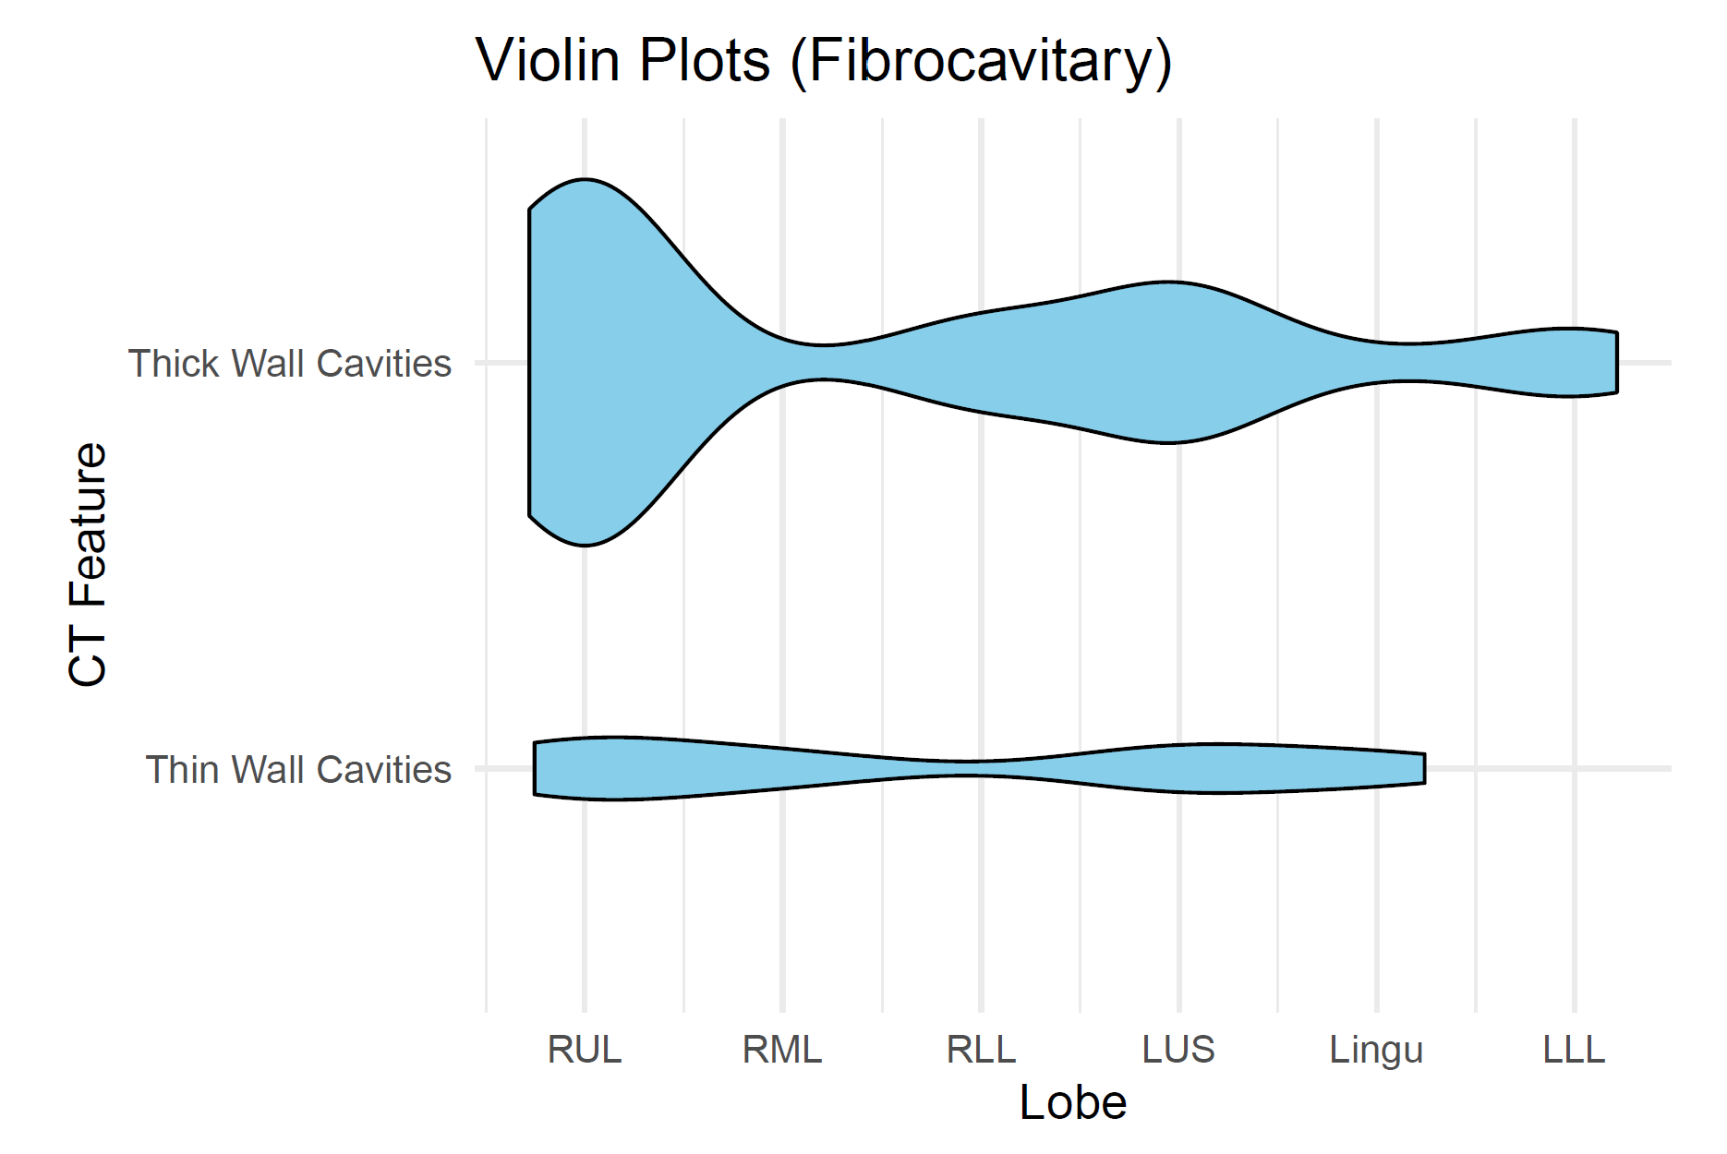
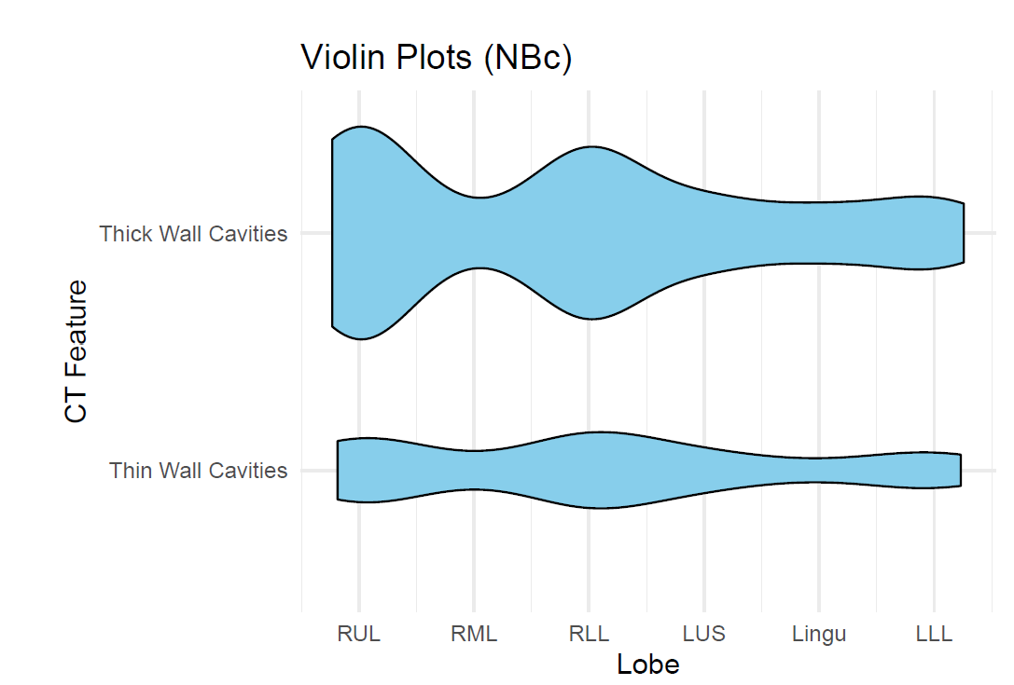
Cavities
 | Fibrocavitary disease (n=13)
Cavity | RUL | RML | RLL | LUS | Lingu | LLL
Thick-wall | 11 85% | 0 0% | 2.5 19% | 4.5 35% | 0.5 3.9% | 2 15%
Thin-wall | 2 15% | 1 8% | 0 0% | 1.5 12% | 1 7.7% | 0 0%
Nodular BXSIS with cavity (n=36)
RUL | RML | RLL | LUS | Lingu | LLL
16 44% | 2 6% | 13 35% | 4.5 13% | 3.5 10% | 5 14%
5.5 15% | 1 3% | 6 17% | 2.5 7% | 1 3% | 3 8%
All cavities: RUL, RLL, LUS > others (OR 2.340-58.29)
Fibrocavitary disease
Nodular BXSIS with cavity
Thick-wall
cavity
Thin-wall
cavity
RUL
RML
RLL
LUS
Lingu
LLL
RUL
RML
RLL
LUS
Lingu
LLL

Slide 11
Interim summary
Bronchiectasis & atelectasis are most common & severe in the RML and lingula (not surprising).
GGO & tree-in-bud opacities are most common in the RLL and LLL …possibly a sign of endobronchial spread?
NTM lung cavities
62% of all cavities occur in either the RUL or LUL.
40% of all cavities occur in the RUL (15% of the entire lung volume).
With NBc, the RLL was the second most common site for cavities.

Slide 12
Why are NTM (& TB) cavities more common in the upper lobes?
Decreased blood perfusion
Decreased lymphatic formation
Increased P_{A}O₂
Increased pH
Increased stiffness & mechanical stress on lung tissue
0.07
0
0
7.51
132
200
80
1.30
24
+++
7.39
Perfusion
(L/min)
P_{PA}
(mmHg)
89
30
10
Lymph
flow
pH
P_{A}O₂
(mmHg)
Stiffness (kPa)
Stress (kPa)
Decreased influx of immune cells, soluble mediators, & antibiotics
Decreased clearance
of NTM & antigens
Increased Warburg → decreased of both autophagy & killing of NTM
Increased aerobic growth of NTM
Increased risk of cavitation
Casha AR et al. J Infect Dis Epidemiol 2018
Shi L…Suki B. Scientific Rep 2022

Slide 13
Experimental animal models show that lower alveolar oxygen tension decreases the severity of TB
Mice, guinea pigs, and rabbits infected with MTB and housed in 10% O₂ had significantly longer survival than those kept at 21% O₂.
Elevation | Effective O₂ concentration
Sea level | 20.9%
5,000 feet | 17.3%
14,000 feet | 12.43%
19,000 feet | 10.1%
29,000 feet | 6.9%
https://milehightraining.com/altitude-to-oxygen-chart/
Rich AR, Follis RH. The effect of low oxygen tension upon the development of experimental tuberculosis.
Bull Johns Hopkins Hosp 1942; 71:345-363

Slide 14
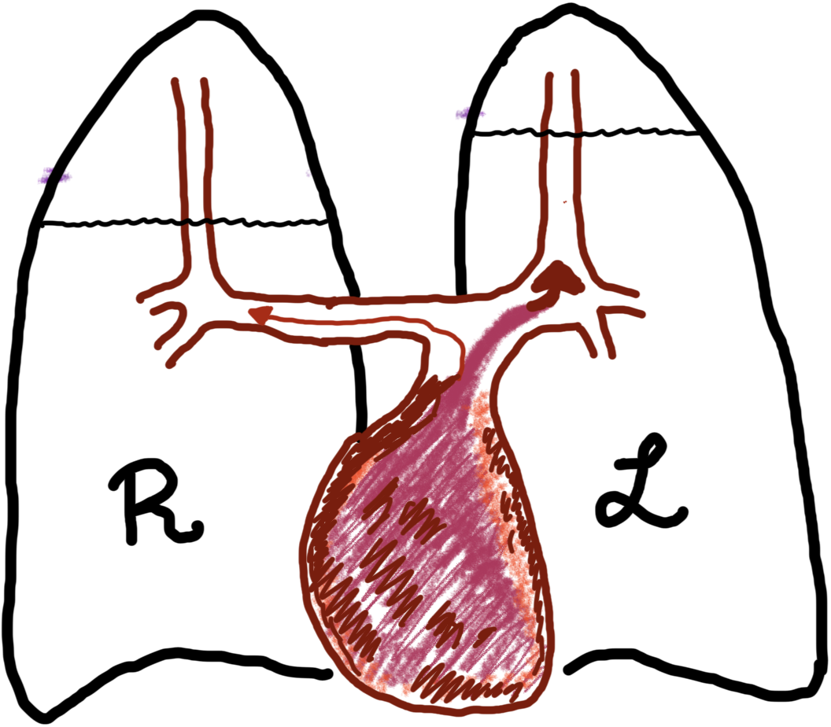
Why is the RUL more commonly affected by NTM cavities than the LUL?
*
A more tortuous route of the right PA reduces the blood flow even more to the RUL.
*
This effect, being more pronounced in tall individuals, may be the basis for Hippocrates observation that TB is more likely to occur in them.
*Levels above which PA blood flow cannot be maintained in an upright person
Hippocrates 460-370 BC
Dock W. Am Rev Tuberc 1946
Dock W. Arch Intern Med 1954
West JB & Dollery CT. J Appl Physiol 1960
Murray JF. Am J Respir Crit Care Med 2003

Slide 15
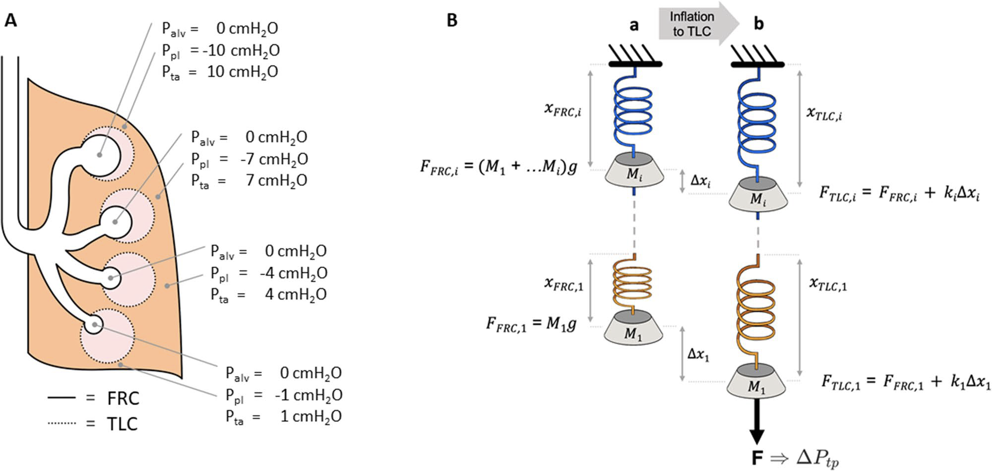
In upright lungs, there are increased force and mechanical stress acting on the upper lobes at both FRC and TLC
FRC: F_{UL}=(m_{UL} + m_{LL})g >> F_{LL}=(m_{LL})g
m_{UL}
Δx_{UL}
m_{UL}
TLC: F_{UL}=(m_{UL} + m_{LL})g + k_{UL}(Δx_{UL}) >> F_{LL}=(m_{LL})g + k_{LL}(Δx_{LL})
FRC
m_{LL}
Δx_{LL}
TLC
m_{LL}
Mechanical stress = ΔForce/ΔArea
Mechanical stress (UL) >> mechanical stress (LL)
Shi L …Suki B. Scientific Rep 2022

Slide 16
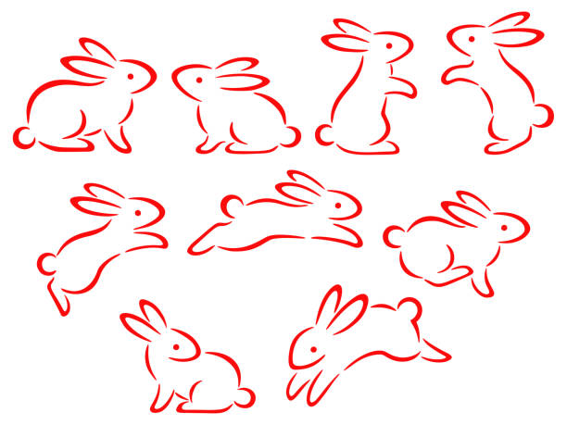
Rabbit model of TB show that the location of pulmonary TB is dictated by direction of the gravitational force
Normally, the dorsal basal lung of the rabbit is most susceptible to TB.
When the rabbits kept vertically for 11 hours/day, TB shifted to the apical dorsal area.
Medlar EM & Sasano KT. A study of the pathology of experimental pulmonary TB in the rabbit. Am Rev Tuberc 1936; 34:456-476

Slide 17
If increased cavities in the RUL is due to increased mechanical stress, why is the RLL the second most common site to have cavities in the NBc?
Nodular BXSIS
Thick-wall
cavity
16
13
Thin-wall
cavity
5.5
6
RUL
RML
RLL
LUS
Lingu
LLL

Slide 18
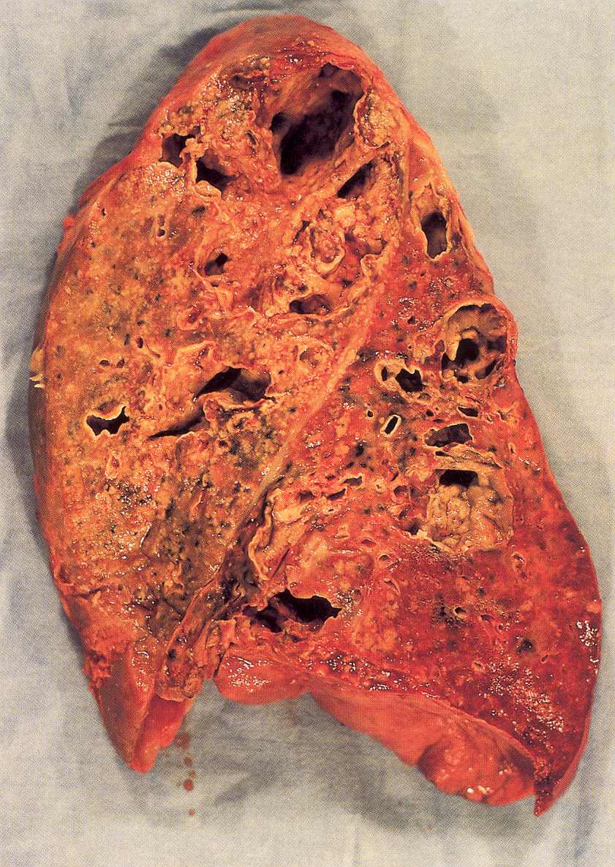
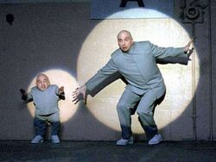
Hypothesis: in the RLL, the superior segment is more proned to cavities than the basilar segments because mechanically, the RLL is like an independent “mini-lung” with decreased blood flow, increased stress, etc
TB
Total right lung
(Dr. Evil)
RLL
(Mini-Me)

Slide 19
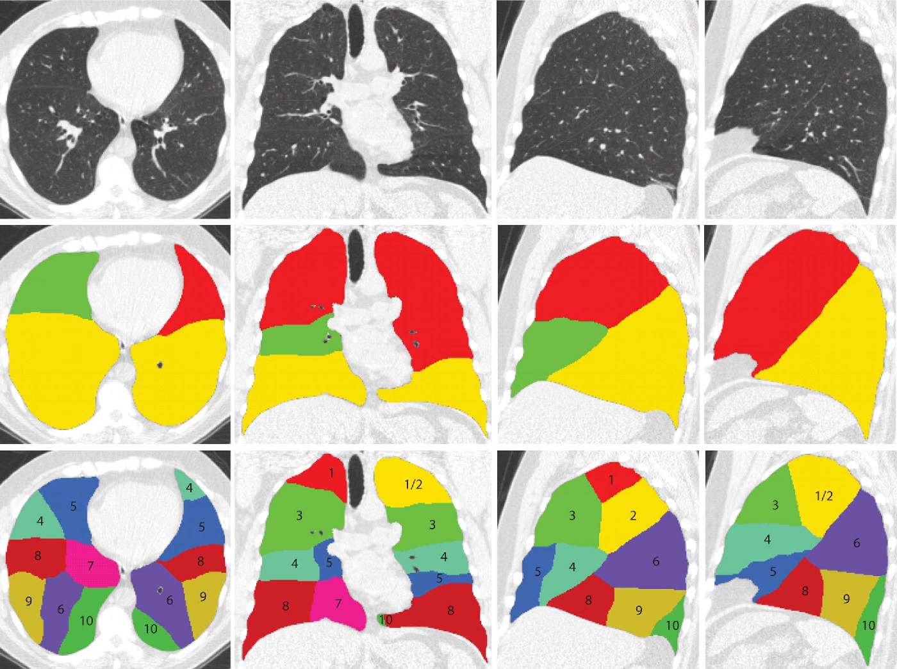
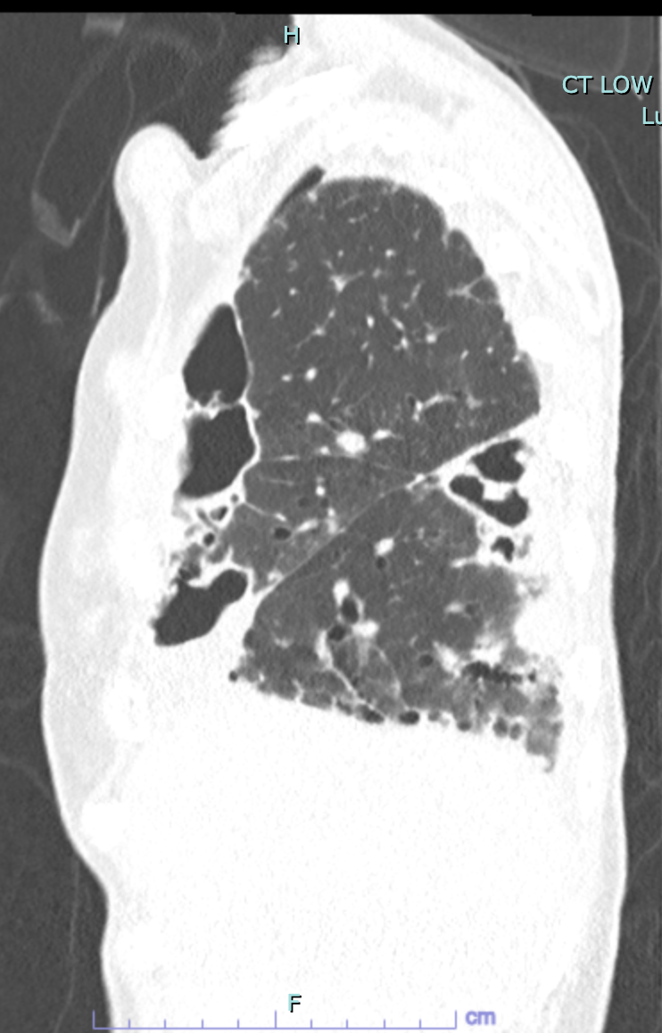
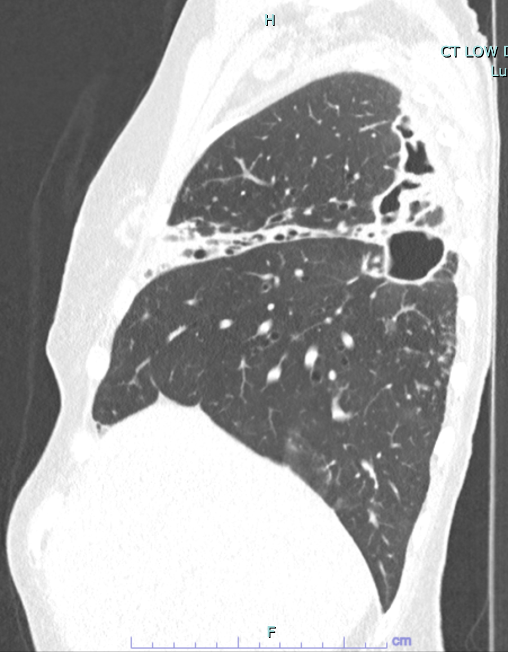
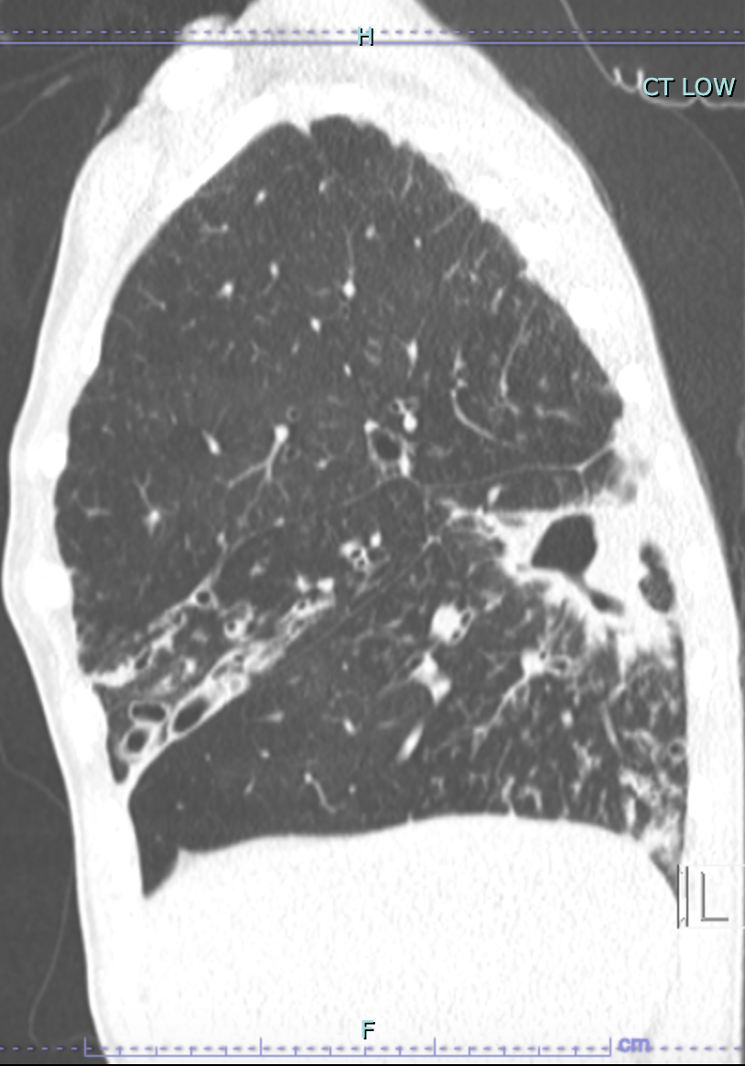
Patient #, CT Date | Cavity location in RLL
Patient 1, 8.15.2023 | Superior segment (SS)
Patient 2, 1.10.2023 | SS
Patient 3, 8.30.2023 | SS
Patient 4, 8.1.2023 | SS
Patient 5, 5.9.2023 | SS
Patient 6, 12.6.2023 | SS
Patient 7, 1.22.2024 | SS
Patient 8, 5.24.2023 | SS
Patient 9, 5.31.2023 | SS
Patient 10, 6.1.2023 | SS
Patient 11, 6.8.2023 | SS
Patient 12, 8.11.2023 | R posterior basal?
Patient 13, 6.15.2023 | R posterior basal?
Patient 14, 6.27.2018 | SS
Patient 15, 5.29.2024 | SS
Patient 16, 11.9.2017 | SS
Patient 17, 2.20.2024 | R posterior basal?
Patient 18, 4.7.2023 | SS
Patient 19, 3.24.2023 | SS
Patient 4
August 1, 2023
Patient 7
Jan 22, 2024
Patient 8
May 24, 2023

Slide 20
Are there simple things we should be advising our NTM patients with cavities in the upper lobes or SS-LL?
Summary of NTM lung cavities
Nearly 2/3 of all cavities occur in the upper lobes, especially the RUL.
Decreased blood flow and lymphatic formation as well as increased pH, P_{A}O₂, and mechanical stress in the upper lobes may account for this.
In nodular-BXSIS phenotype, the RLL was the second most common site of cavities, and the superior segment accounted for 84% of them (”mini-lung”).
No Δ in distribution of cavities based on MAC vs. M. abscessus group.
Should they be lying down more when resting?
Should they be lying down when getting IV (or inhaled) antibiotics?
Should NTM-LD patients with upper lobe cavities refrain from excessive exercise?

Slide 21
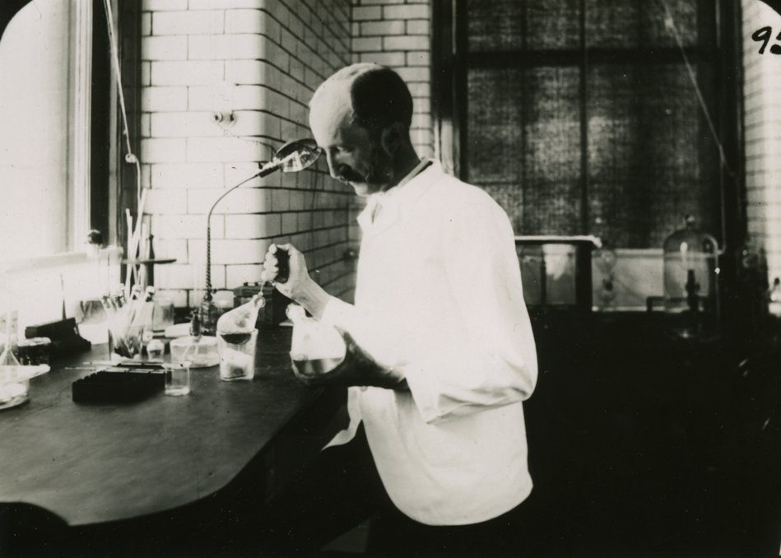
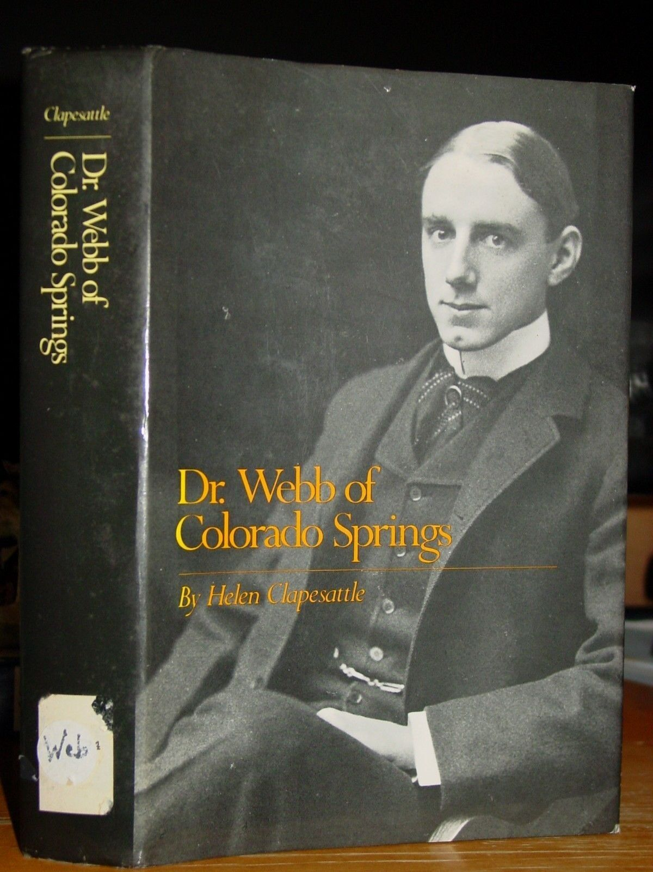
I know I have hurt nobody by rest, but I am quite sure I often have by allowing them to exercise (Edward Livingston Trudeau, MD, 1848-1915, New York).
A good rule is the following: Never stand when you can sit, never sit when you can lie down (Gerald Webb, MD, 1871-1949, Colorado) in Webb GB & Ryder CT. Overcoming TB: An Almanac of Recovery, 3rd edition, 1927).

Slide 22








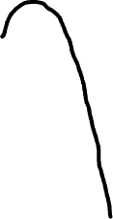














Hypothesized mechanisms by which the RML, lingula, and RUL are more severely affected by NTM lung disease
RUL
HYPOTHESIZED MECHANISMS
1) Less acute angle of right mainstem takeoff
2) Secretions down the medial wall of bronchus intermedius more likely to enter the RML
3) Narrower orifice of the RML
4) Secretions enter the ventral RML & lingula during prone position
5) Less acute angle of lingula bronchus
6) Effects of the beating heart on microatelectasis and macrophage phenotype
7) Electrical influence of the heart on cilia function
8) Decreased lymphatic flow of the upper lobes
9) Secretions enter RUL with supination and right lateral decubitus
8
9
1
2
5
3
RML
7
4
4
6
lingula

